Slide 1

AI-based electric vehicles charging strategy considering user behavior
Faculty of Electrical Engineering and Informatics
Department of Control Engineering and Information Technology
Shahab Sabzi
Supervisor: Dr. Laszlo Vajta
June 2022

Slide 2
Research Objectives
Driver Behavior Modeling
Developing a Deep-Learning method to predict the EV drivers behavior
The output of this modeling will be used in the EV charging coordination solution
A systematic approach that influences the driver’s charging behavior toward intelligent utilization of e-mobility
By this method, clustering of drivers will be possible, based on price sensitivity, time sensitivity, SoC sensitivity
Charging Coordination Development
After the behavior modeling
The aim will be to optimize or achieve one or more objectives subject to some constraints
There will be demand side management concept
EV, Utility company and Aggregator will be involved
The method can be based on mathematical optimization, game-theory and other methods

Slide 3
Challenges caused by the EVs emerge
EVs are beneficial for many reasons such as reducing pollution and dependency on fossil fuels but they have their own challenges.
Impacts on Power Quality | Impacts on the energy-related matters
Harmonics Sag/Swell Flicker Notches Voltage Imbalance | Inhomogeneous load profile Transformer overloading Shortage of energy Need for new electricity infrastructures
Some solutions to handle energy related issues:
Energy storage and generation installment
Developing new infrastructures
Smart charging

Slide 4
Effects of EVs on a modified IEEE 31 bus distribution network
We carried out this research to see the effects of EVs on distribution grid
IEEE 31 bus 23 kV distribution system combined with several residential LV 415 V networks
Each LV feeder consisted of 19 nodes representing customer households considering additional loads as EVs.
Two simulation scenarios:
Baseload
EVs added into the network dumb charging or uncontrolled charging was considered

Slide 5
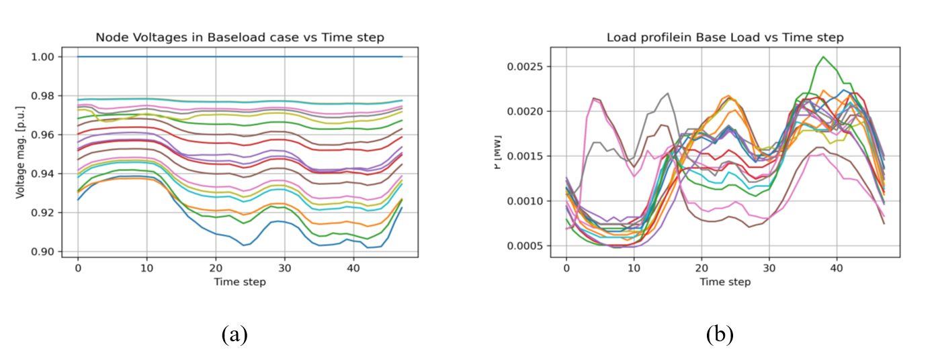
Effects of EVs on a modified IEEE 31 bus distribution network
Simulation results
peak: 26 kW
Baseload scenario (48 data recorded in half an hour intervals for every node, so intervals are 30 minutes)
Highest voltage drop on the endpoint nodes, which are far away from the main transformer
Simulation results for baseload scenario, a) Voltage on nodes , b) Power demand

Slide 6
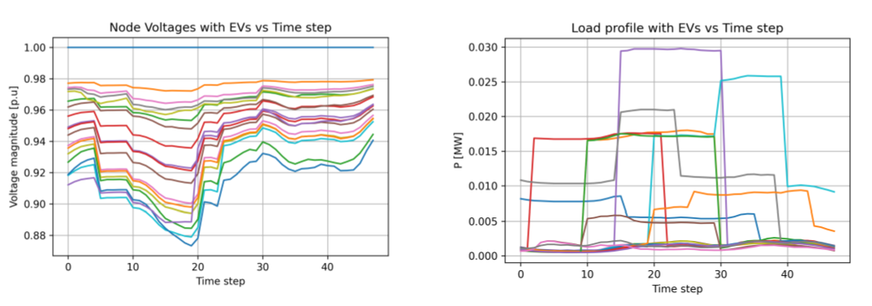
Effects of EVs on a modified IEEE 31 bus distribution network
Simulation results
Uncontrolled EVs charging: (50 EVs with different features were defined home charging)
Simulation results for uncontrolled EV charging scenario, a) Voltage on nodes , b) Power demand

Slide 7

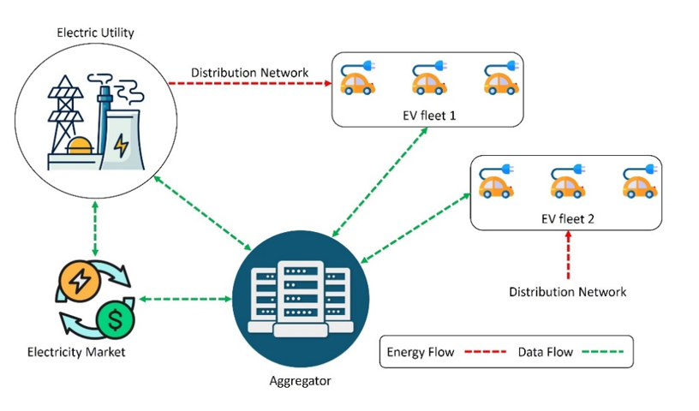
Different actors in the network
Three actors are mainly involved in the charging operation, each with its own goals and interests. Each of these actors plays a specific role in the system and influences the energy consumption and cost regulation differently.
Utility
EV users
Aggregators
we carried out systematic
research (review paper) on
the role and interests of actors

Slide 8
EVs smart charging strategies
Mathematical optimization methods;
Meta-heuristic and Heuristic optimization methods;
Learning-based methods;
Game-theory-based methods.
Linear programming
MILP
Augmented Lagrangian
Complex combinatorial
Supervised learning
Convolutional neural networks
Long short term memory
etc.
SVM
Tabu Search
GA
PSO
GWO
IBGWO
Meta-heuristic and Heuristic
optimization methods
Stackberger game
Matching theory
Mathematical optimization methods
Learning-based methods
Game-theory-based methods

Slide 9
Optimization problem statement and formulation
If the problem is stated as optimization, objective functions and constraints must be investigated.
Objective function maximized or minimized subjected to constraints
we conducted a review of the optimization problem statement and formulations, where we investigated different objective functions and constraints in a grid with the integration of EVs.
Network constraints | Vehicle constraints
Distribution network voltage | Charge and discharge rates
Line to neutral voltage deviation | Discharge power in V2G mode
Three-phase voltage unbalance factor | Time of charge
Amount of power demand
Power losses in the network
THD in the network
Maximum allowable switching of capacitors
Daily number of switching operation

Slide 10
Security considerations of EVs smart charging
Importance
If we can’t guarantee privacy and security, drivers will not be willing to give us their information, and utility company will not trust our algorithm
Our algorithm will utilizes sensitive data of drivers, and the network
The actors are connected to clouds and exchange information through internet
If the systems is breached and hackers can make false commands to drivers, there will be the risk for critical infrastructures breakdown
This kind of attacks can lead to incidents such as overloading transformers and therefore further damage to infrastructures
Therefore, the whole platform is vulnerable to data breaches, and security and privacy becomes an essential factor to consider.
Therefore to prevents future harms, I conducted a review-based research on security aspects of EV-integrated grids to foresee the security challenges of our designed model and prevent such future issues.

Slide 11
Security considerations of EVs smart charging
Security threats in such systems are summarized in the below table:
Main attacks related to EVCSMS | Type of attack
Attacks Against the EVCS | Charging Process and Settings Manipulation. Firmware Manipulation Billing Manipulation Bot Recruitment and Network Proxy Denial of Service (DoS)
Attacks Against the User | Charging Data/Record Theft. Payment Fraud Personally Identifiable Information Leakage
Attacks Against the Power Grid | frequency instability attacks Increase in Charging Demand
Some standards to follow while designing such system
SAE J2293 | SAE J2836/2 | J2847/3
SAE J2836/1 | J2847/2 | SAE J2931
J2847/1 | SAE J2836/3 | SAE J2931/2
This research was supported by IoTAC —H2020 project

Slide 12
Drivers' behavior modeling using deep learning
In our research we will develop an algorithm based on artificial intelligence methods to forecast drivers behavior in charging
This algorithm will determine the level of price sensitivity, time sensitivity and SoC sensitivity based on socio-demographics attributes
The developed model then will be used as an input in charging coordination, where the output of the optimization problem will be charging offers to drivers
It is targeted to affect the charging behavior of drivers in futures

Slide 13
Drivers' behavior modeling using deep learning
To develop the deep-learning model we needed a database that is consistent with our needs.
Dataset is prepared using a questionnaire.
So far, the dataset has been mostly prepared.
After obtaining the dataset, the next step would be to develop a deep learning method which best fit our dataset
In our questionnaire, we asked Hungarian drivers the following socio-demographic questions:
Driving experience
Since when they are using EVs
Age
Gender
Education level
Income

Slide 14
Drivers' behavior modeling using deep learning
In our questionnaire we asked EV users in Hungary whether they would charge in a particular situation. The situation is made of SoC, the queuing time, and the charging fee. For each parameter, we considered the values shown in the Table. Therefore, since we have three parameters and each has three values, the total number of questions is Q_{total}=3³=27.
Parameter | Values
SoC (%) | 10 – 30 | 31 – 50 | 51 – 70
Queuing time (minutes) | 0 | 15 | 30
Charging fee | Below average | Average | Above average
Assuming a total of 100 EV users answer my survey, each person will provide 270 data points for us, and in the end, we will have a dataset consisting of 27000 data points. After completing the dataset, I will decide which deep learning method will be used since the classification will be of binary classification type.

Slide 15
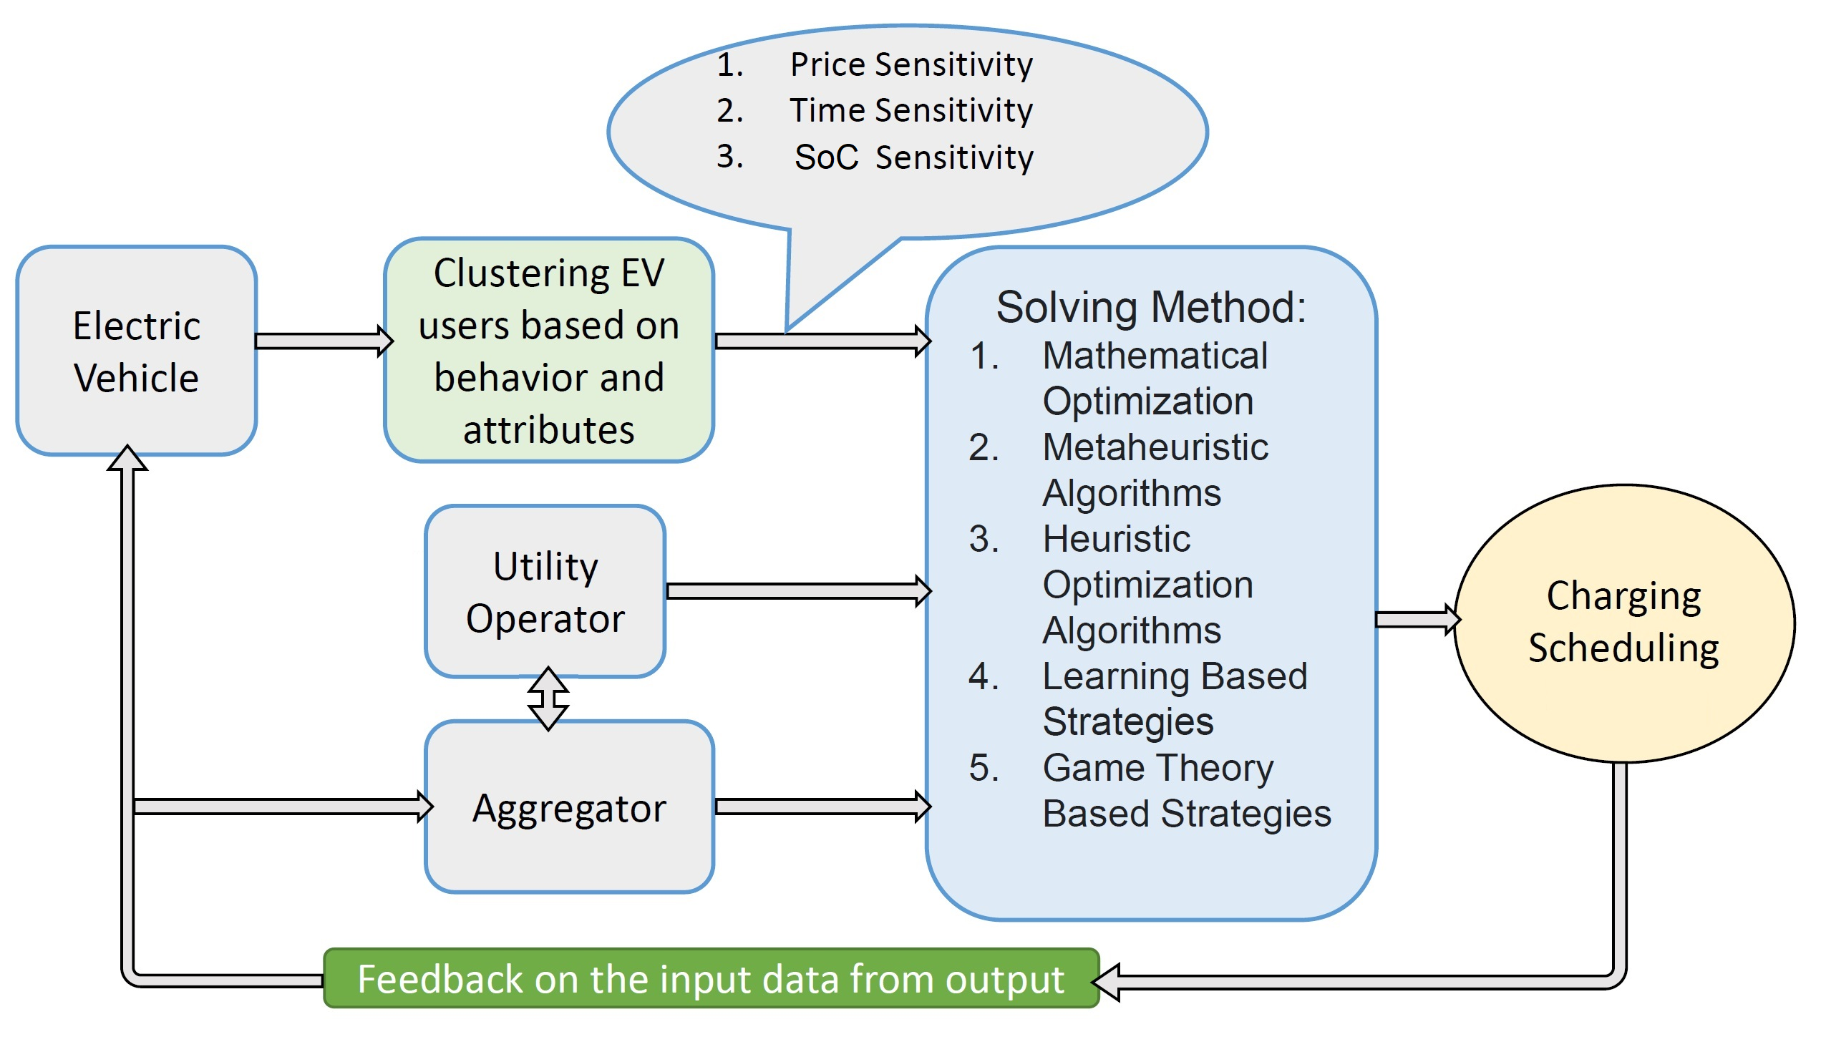
A preliminary plan of the future algorithm

Slide 16
Plans for the future of my research
Finishing the driver’s behavior modeling and publishing the results in a Q1 journal
Developing the charging coordination plan with the drivers behavior as an input
Developing the real time charging coordination and simulation in real-time simulation program such as SUMO (Simulation of Urban Mobility)
Based on my articles so far and my results, I have received a 6-month research visiting grant from University of Southern Denmark to progress my research at that University, they have a professional team working on the same subject

Slide 17
Publications
Journals
Sabzi, S., Vajta, L., Faghihi, T. “A Review on Electric Vehicles Charging Strategies Concerning Actors Interests”, Periodica Polytechnica Electrical Engineering and Computer Science, 66(2), pp. 148–162, 2022. https://doi.org/10.3311/PPee.19625
Sabzi, S., Vajta, L., "Security and Energy Consumption Considerations of Electric Vehicles Integration in Smart Grids", U.Porto Journal of Engineering (ISSN 2183-6493). Accepted for publication
Conferences
Sabzi, S., Vajta, L. "Effects of Electric Vehicle Charging Stations on Electricity Grid: Challenges and Possible Solutions", presented at WAIT: Workshop on the Advances in Information Technology, Budapest, Hungary, Jan. 28. 2021. Available Online
Faghihi, T., Sabzi, S., Vajta, L. "Effects of Electric Vehicles and PV Units on the Distribution Network, a Modified IEEE 31 Buses Distribution Network Case Study", presented at WAIT 2022: Workshop on the Advances in Information Technology, Budapest, Hungary, Feb. 03. 2022. Available Online
17

Slide 18
Thank you for your attention

